Slide 1

SELFIE BEAUTIFICATION FILTER
Class: 152446
Instructors: Assoc. Prof. Lê Thị Lan
Assoc. Prof. Trần Thị Thanh Hải
Trần Minh Hà
Nguyễn Mai Hương
- 20224309
- 20224314

Slide 2
Introduction
01

Slide 3
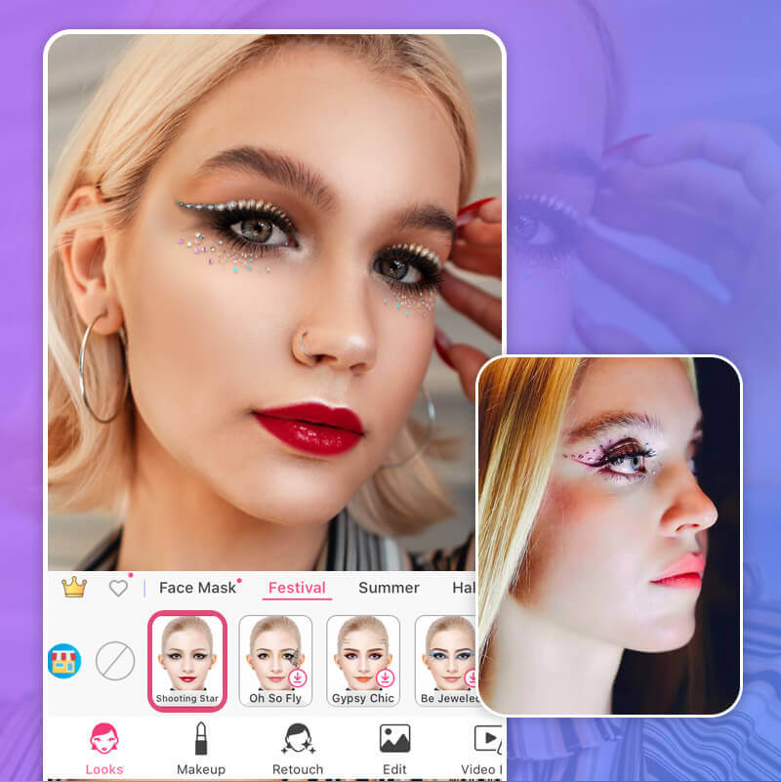
1.1. Problem statement
The rise of social media and augmented reality demands real-time beautification filters to enhance visual appeal.
These filters must handle skin smoothing, color adjustments, and accessory overlays with precise facial alignment.
This project addresses challenges in real-time performance, lighting variability, and alignment accuracy.

Slide 4
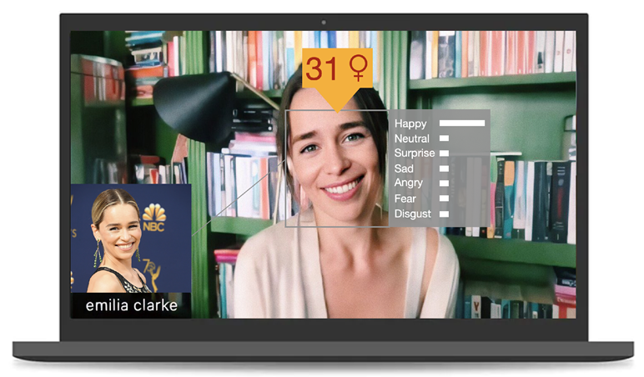
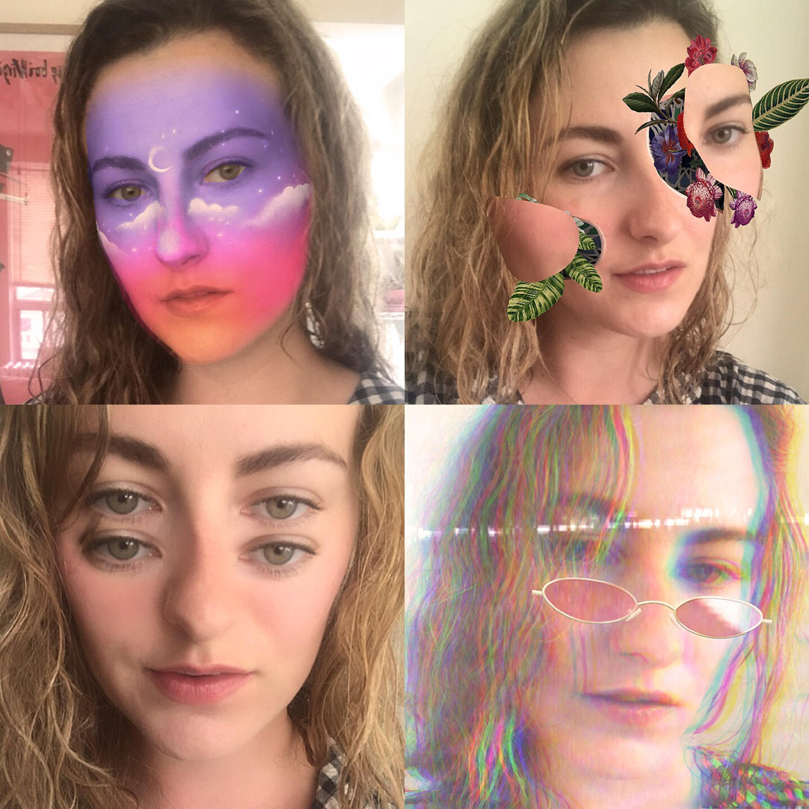
1.2. Input / Output
Input: Real-time video feed from a webcam
Output: Enhanced video feed with applied beautification

Slide 5
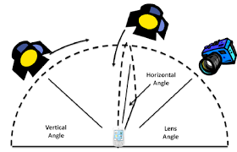
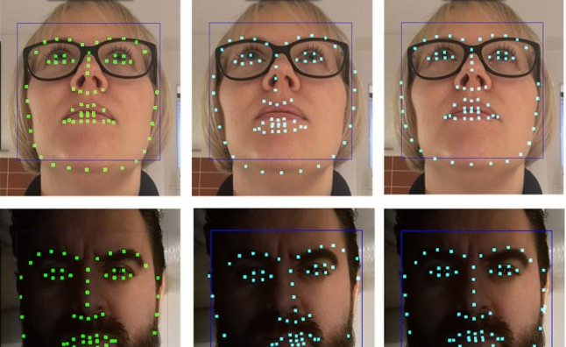
1.3. Challenges
• Maintaining accurate filter placement during facial movements.
• Ensuring real-time performance without noticeable latency.
• Adapting to varying lighting conditions and camera distances.
• Integrating multiple filters while maintaining system stability.

Slide 6
Related works
02

Slide 7
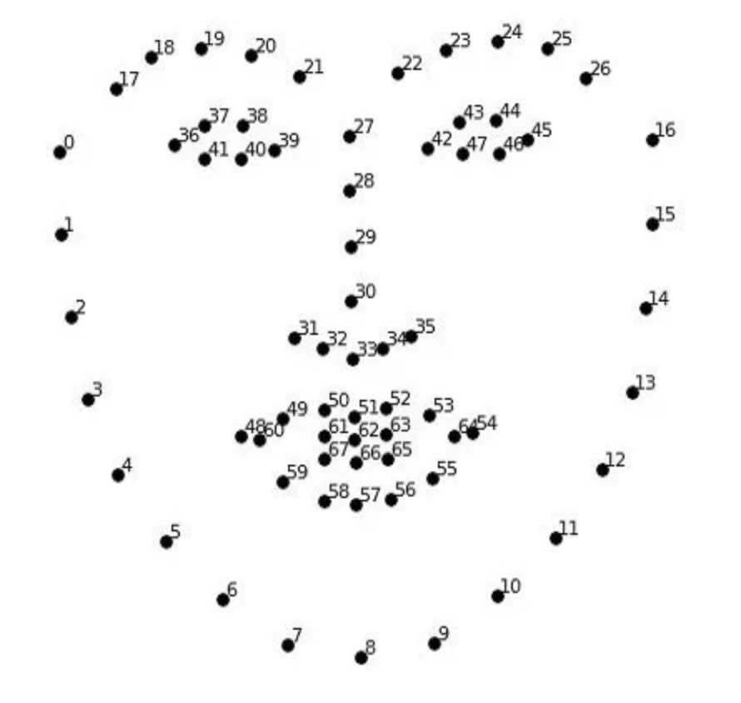
2.1. Facial Landmark Detection
Traditional Methods:
Viola-Jones Algorithm (2001): Efficient real-time face detection but struggled with non-frontal faces and lighting.
ASMs and AAMs: Used statistical models but required high computational resources and were sensitive to errors.
Modern Approaches:
Dlib’s 68-point Model: Combines HOG and SVM for accurate and efficient landmark detection in real-time.
Deep Learning Models: MediaPipe Face Mesh and OpenCV DNN provide robust, high-density landmarks using CNNs trained on large datasets.

Slide 8
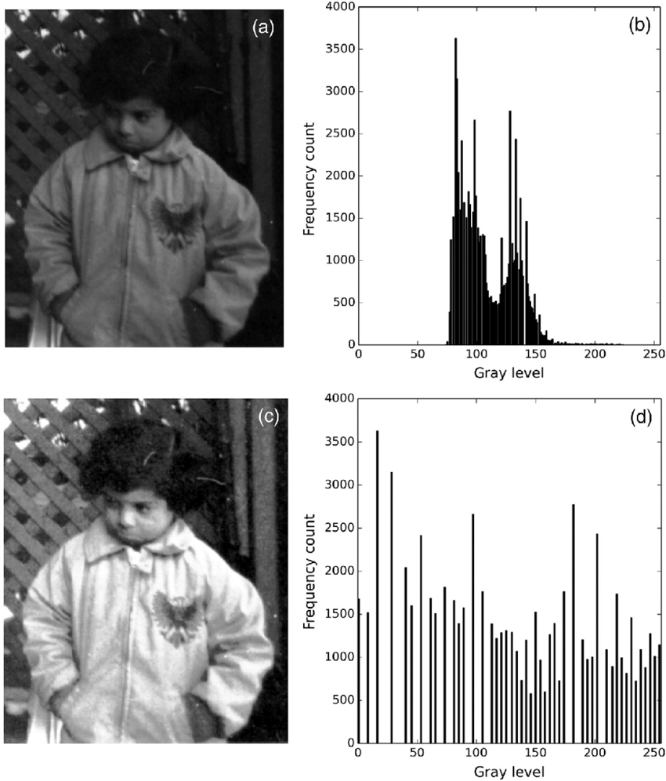
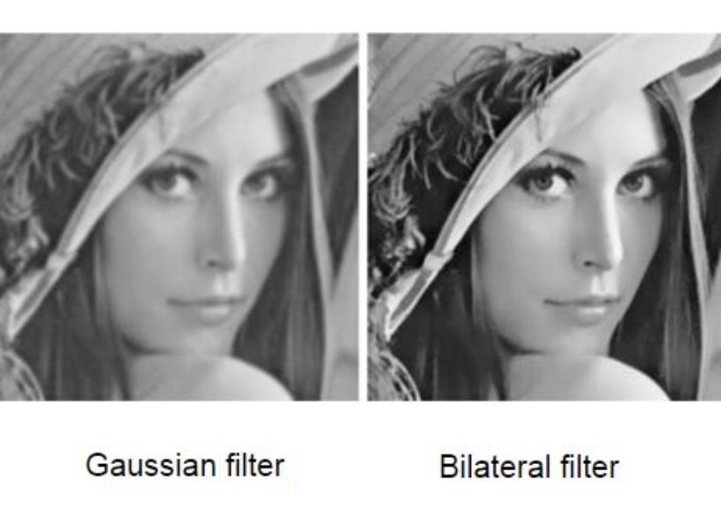
2.2. Beautification Techniques
Traditional Methods:
Histogram Equalization: Improves brightness and contrast but may cause unnatural results.
Gaussian Blur & Bilateral Filtering: Smoothens textures while preserving edges, ideal for skin enhancement.
Advanced Techniques:
GAN-based Models: Enable makeup transfer and skin refinement with realistic transformations.
Edge-Preserving Filters: Enhance specific regions while maintaining structural integrity.

Slide 9
2.3. Accessory Overlays and Augmented Reality
Role: Enhance user interaction in AR by adding hats, glasses, and other accessories with precise real-time alignment to facial features.
Traditional Methods:
Template-based Approaches: Used fixed templates, often inaccurate with dynamic facial movements.
Shape-based Models: Basic adaptability but limited by computational constraints.
Advances with Landmark Detection:
Geometric Transformations: Align accessories using landmarks for scaling, rotation, and placement (e.g., hats above eyebrows, glasses over eyes).
Angle Correction: Uses landmarks to adjust accessories based on face orientation.

Slide 10
Proposed methods
03

Slide 11
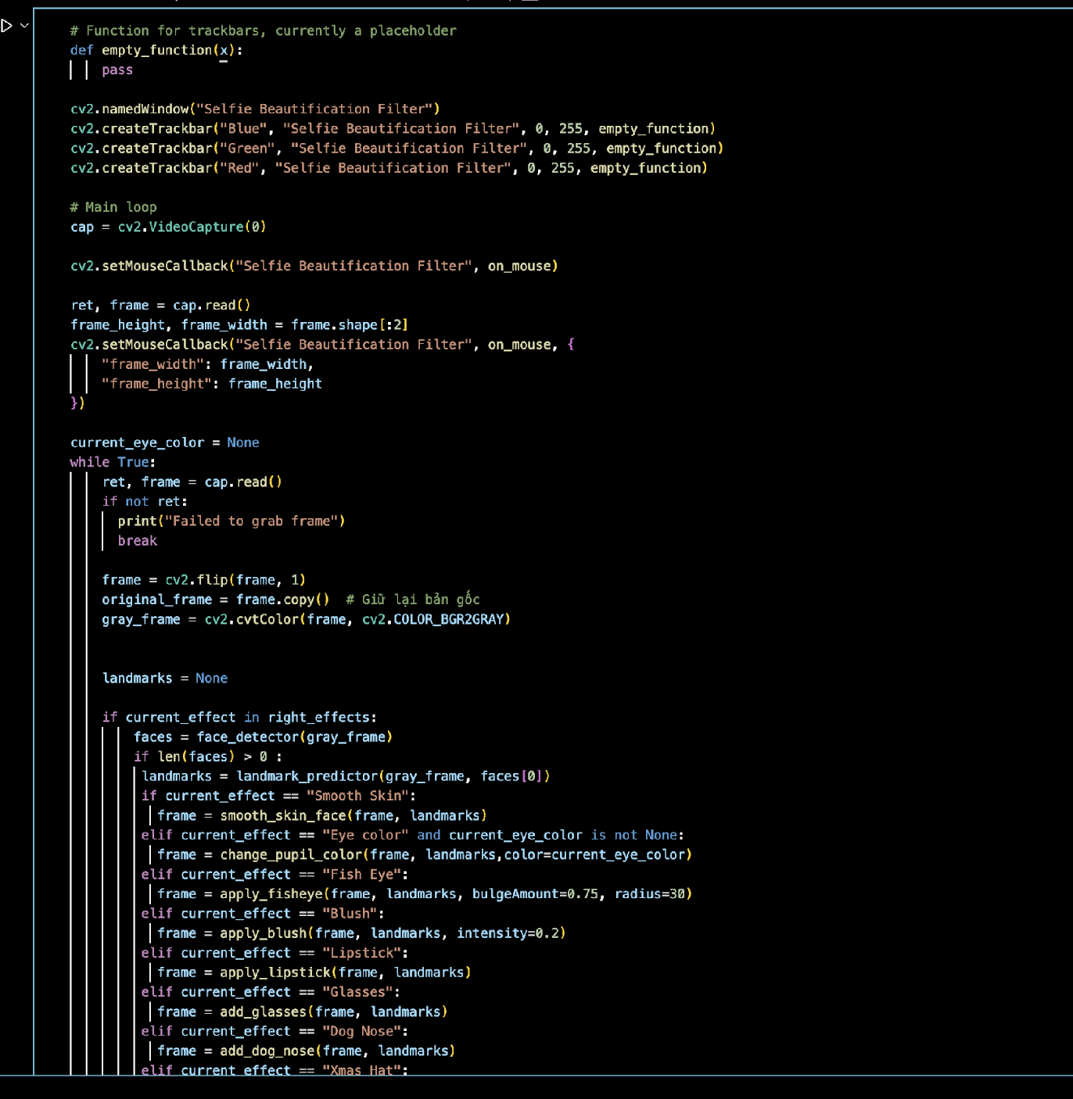
3.1. Data Structure and Workflow
Trackbar Initialization
Video Capture
Facial Landmark Detection
Effect Application
Interactive Controls
Buttons.
Keyboard Shortcuts
Image Capture
Real-Time Display
Exit:

Slide 12
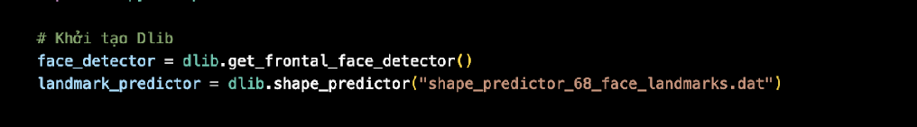
3.2.1. Face Detection and Landmark Detection
Face Detection: Uses HOG (Histogram of Oriented Gradients) and SVM to identify faces by analyzing gradient directions across image regions.
Landmark Detection: Employs Dlib's 68-point model, trained on ensemble regression trees, to precisely locate facial features.

Slide 13
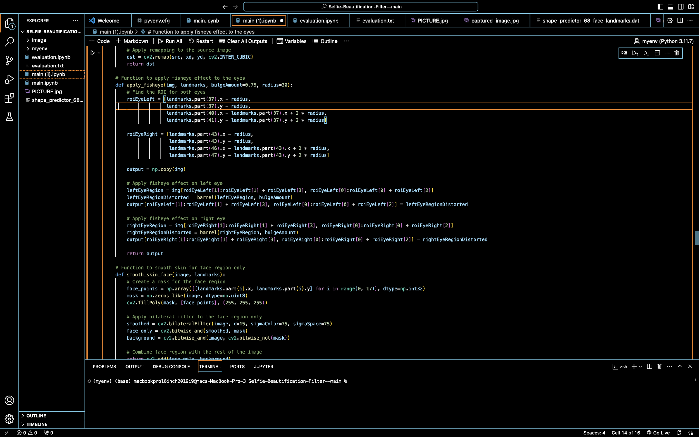
3.2.2. Fisheye Effect for Eyes
ROI (Region of Interest): Eye regions are extracted using landmarks (37–41 for left eye, 43–47 for right eye), extended for effect application.
Barrel Distortion: Pixels are distorted radially
Remapping: New pixel positions are calculated and scaled back to the original image.
Application: Distortion applied independently to both eyes, blending seamlessly into the face.
Output: Stylized bulging eyes with preserved facial features.

Slide 14
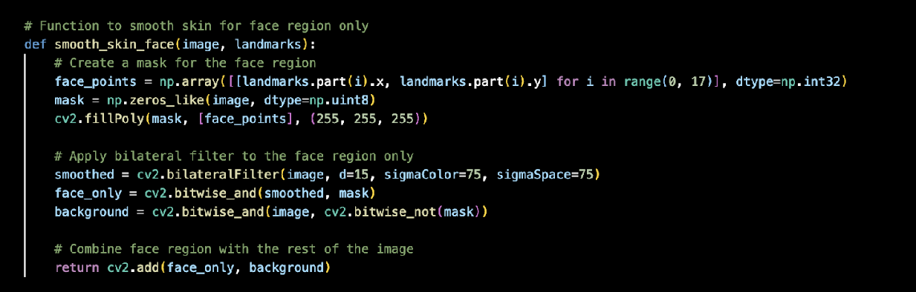
3.2.3. Skin Smoothing Algorithm
Masking: Uses facial landmarks (0–16) to create a mask isolating the face.
Bilateral Filtering: Smooths textures while preserving edges.
Application: Combines the filtered face region with the unaltered background.
Output: Smooths facial textures while maintaining natural transitions.

Slide 15
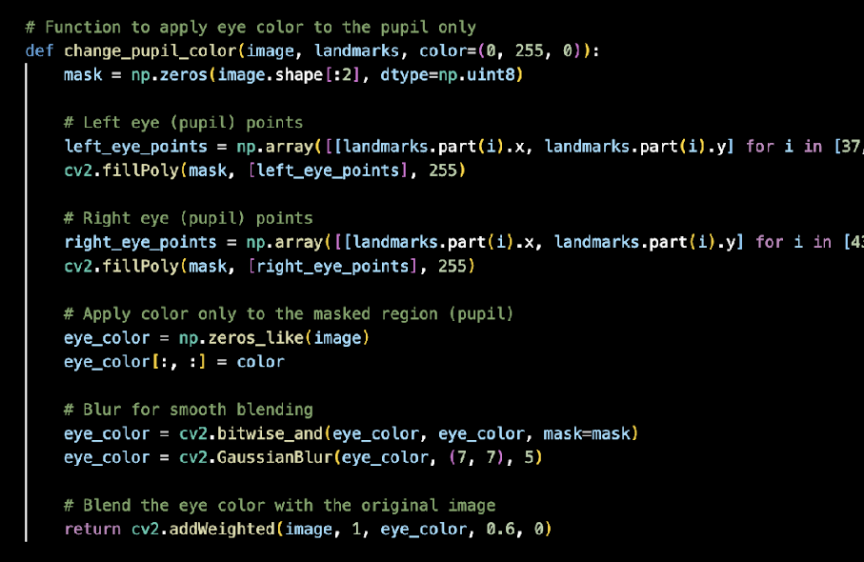
3.2.4. Eye Color Adjustment
ROI: Identifies pupil regions using landmarks (37–41 for left eye, 43–47 for right eye) and creates a mask.
Color Application: Fills the masked region with the desired color.
Smoothing: Applies Gaussian blur for natural transitions.
Blending: Combines the colored region with the original image using weighted addition.
Output: Dynamically adjusts pupil color while maintaining a natural appearance.

Slide 16
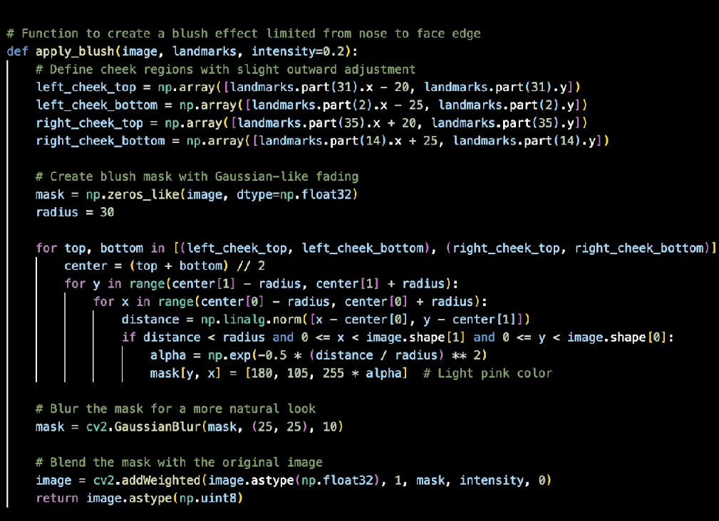
3.2.5. Blush Effect
ROI: Identifies cheek regions using landmarks (31–2 for left cheek, 35–14 for right cheek).
Blush Mask: Applies a Gaussian-like fading with light pink ([180, 105, 255]).
Blurring: Smoothens transitions using Gaussian blur.
Blending: Combines the mask with the original image to control blush intensity.
Output: Adds a natural blush effect to cheeks.

Slide 17
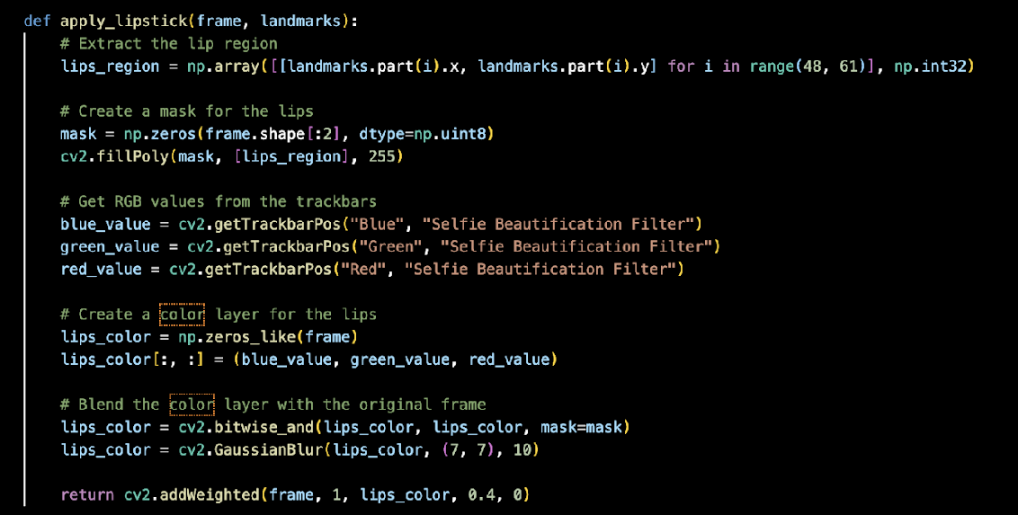
3.2.6. Lipstick Application
ROI: Identifies the lip region using landmarks 48–60 and creates a mask.
Color Selection: Dynamically selects RGB values via trackbars.
Color Layer: Applies the selected color to the masked lip region.
Smoothing: Uses Gaussian blur for natural transitions.​
Blending: Combines the color layer with the original image.​
Output: Enhances the lips with a realistic and customizable lipstick effect.​

Slide 18
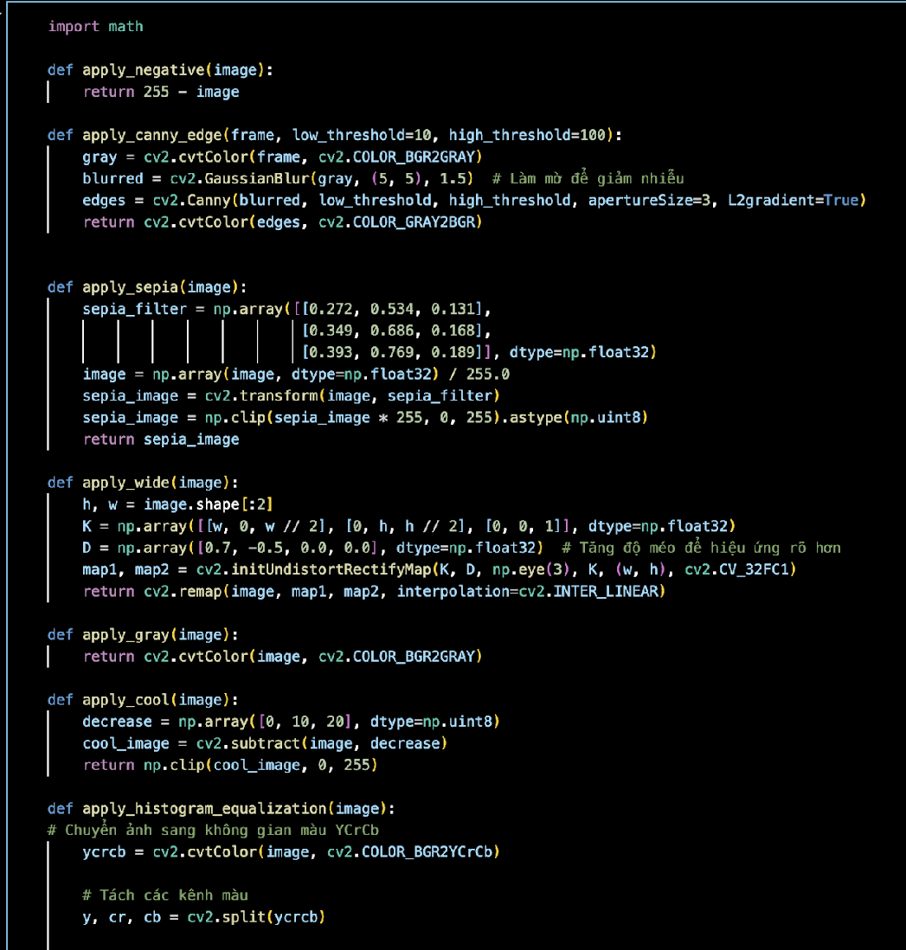
3.2.7. Color Adjustment Filters
Sepia Filter: Applies a vintage tone using a linear transformation of RGB values.
Negative Filter: Inverts pixel intensities for a negative effect
Brightness Adjustment: Modifies brightness (β) and contrast (α)
Histogram Equalization: Enhances contrast by redistributing pixel intensities using the cumulative distribution function (CDF).
Gaussian Blur: Smoothens the image with a Gaussian kernel

Slide 19
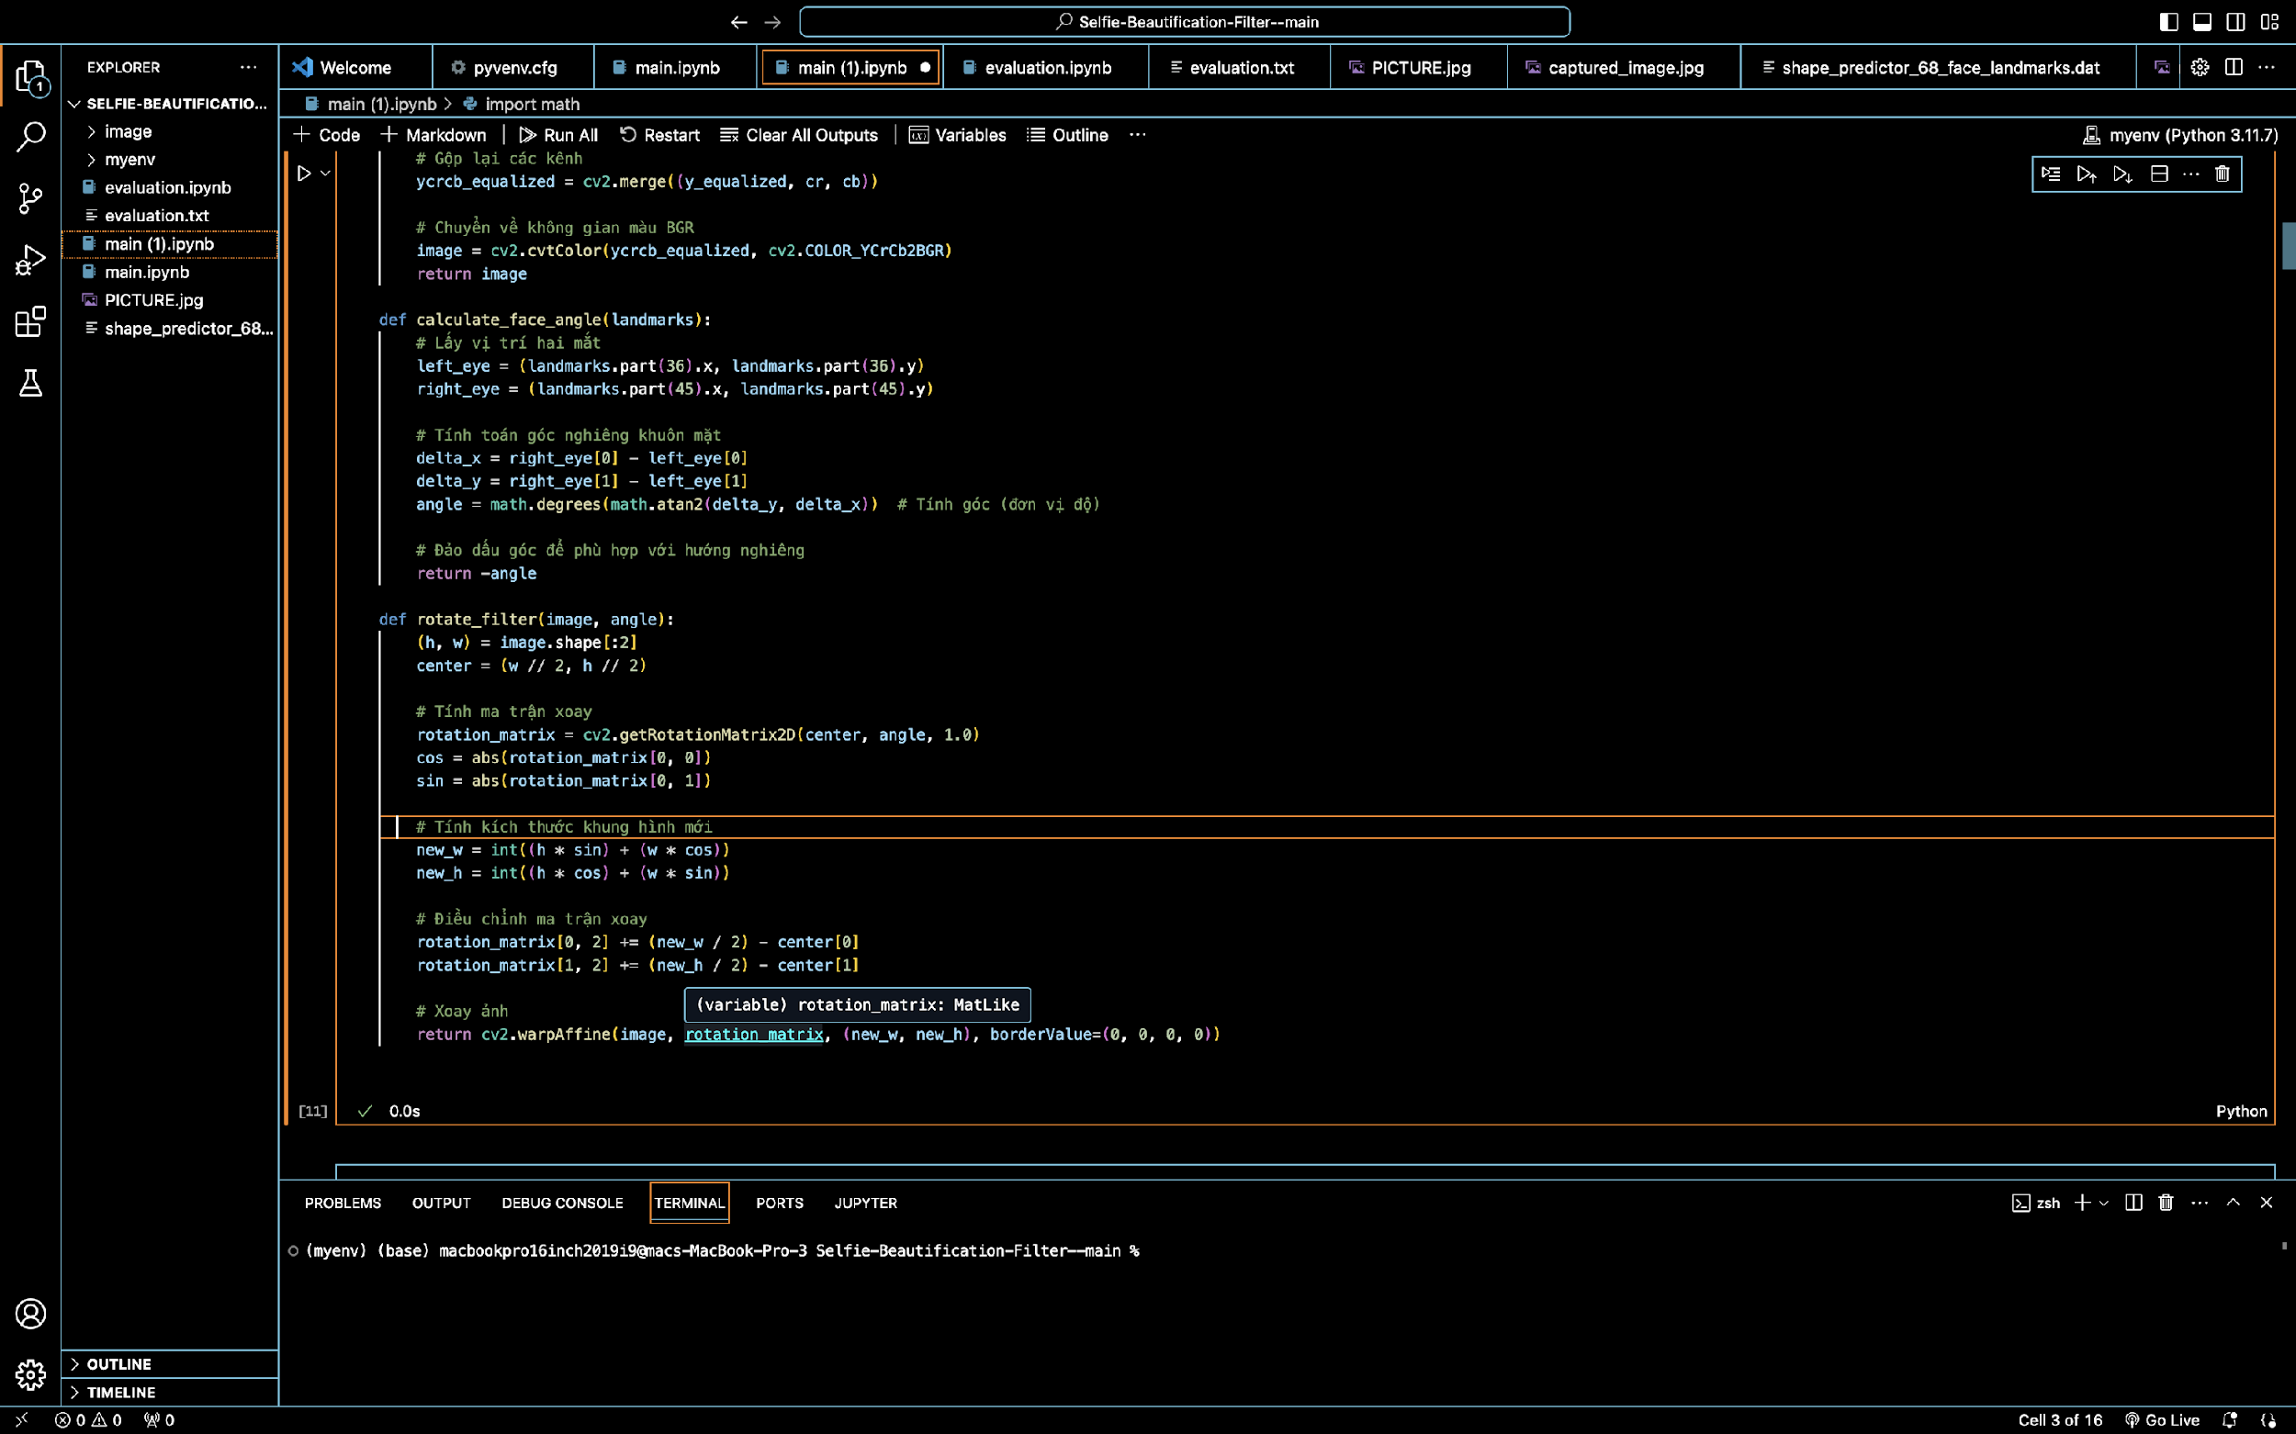

3.2.8. Geometric Transformations
Face Orientation Estimation: Calculates face tilt angle using eye coordinates:
Filter Alignment Rotation: Rotates filters (e.g., hats, glasses) to match face orientation:
(tx,ty: translation adjustments).
Scaling: Dynamically adjusts accessory size based on landmark distances:

Slide 20
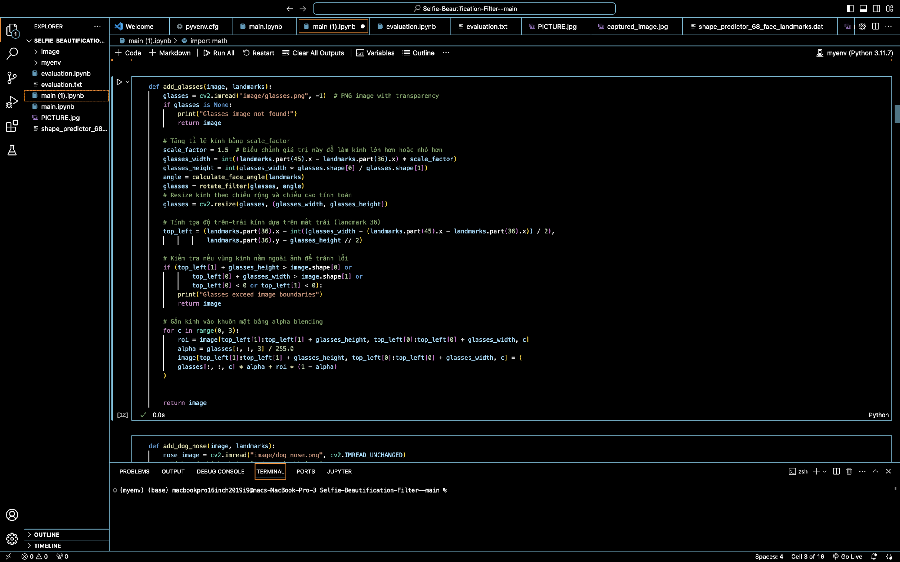
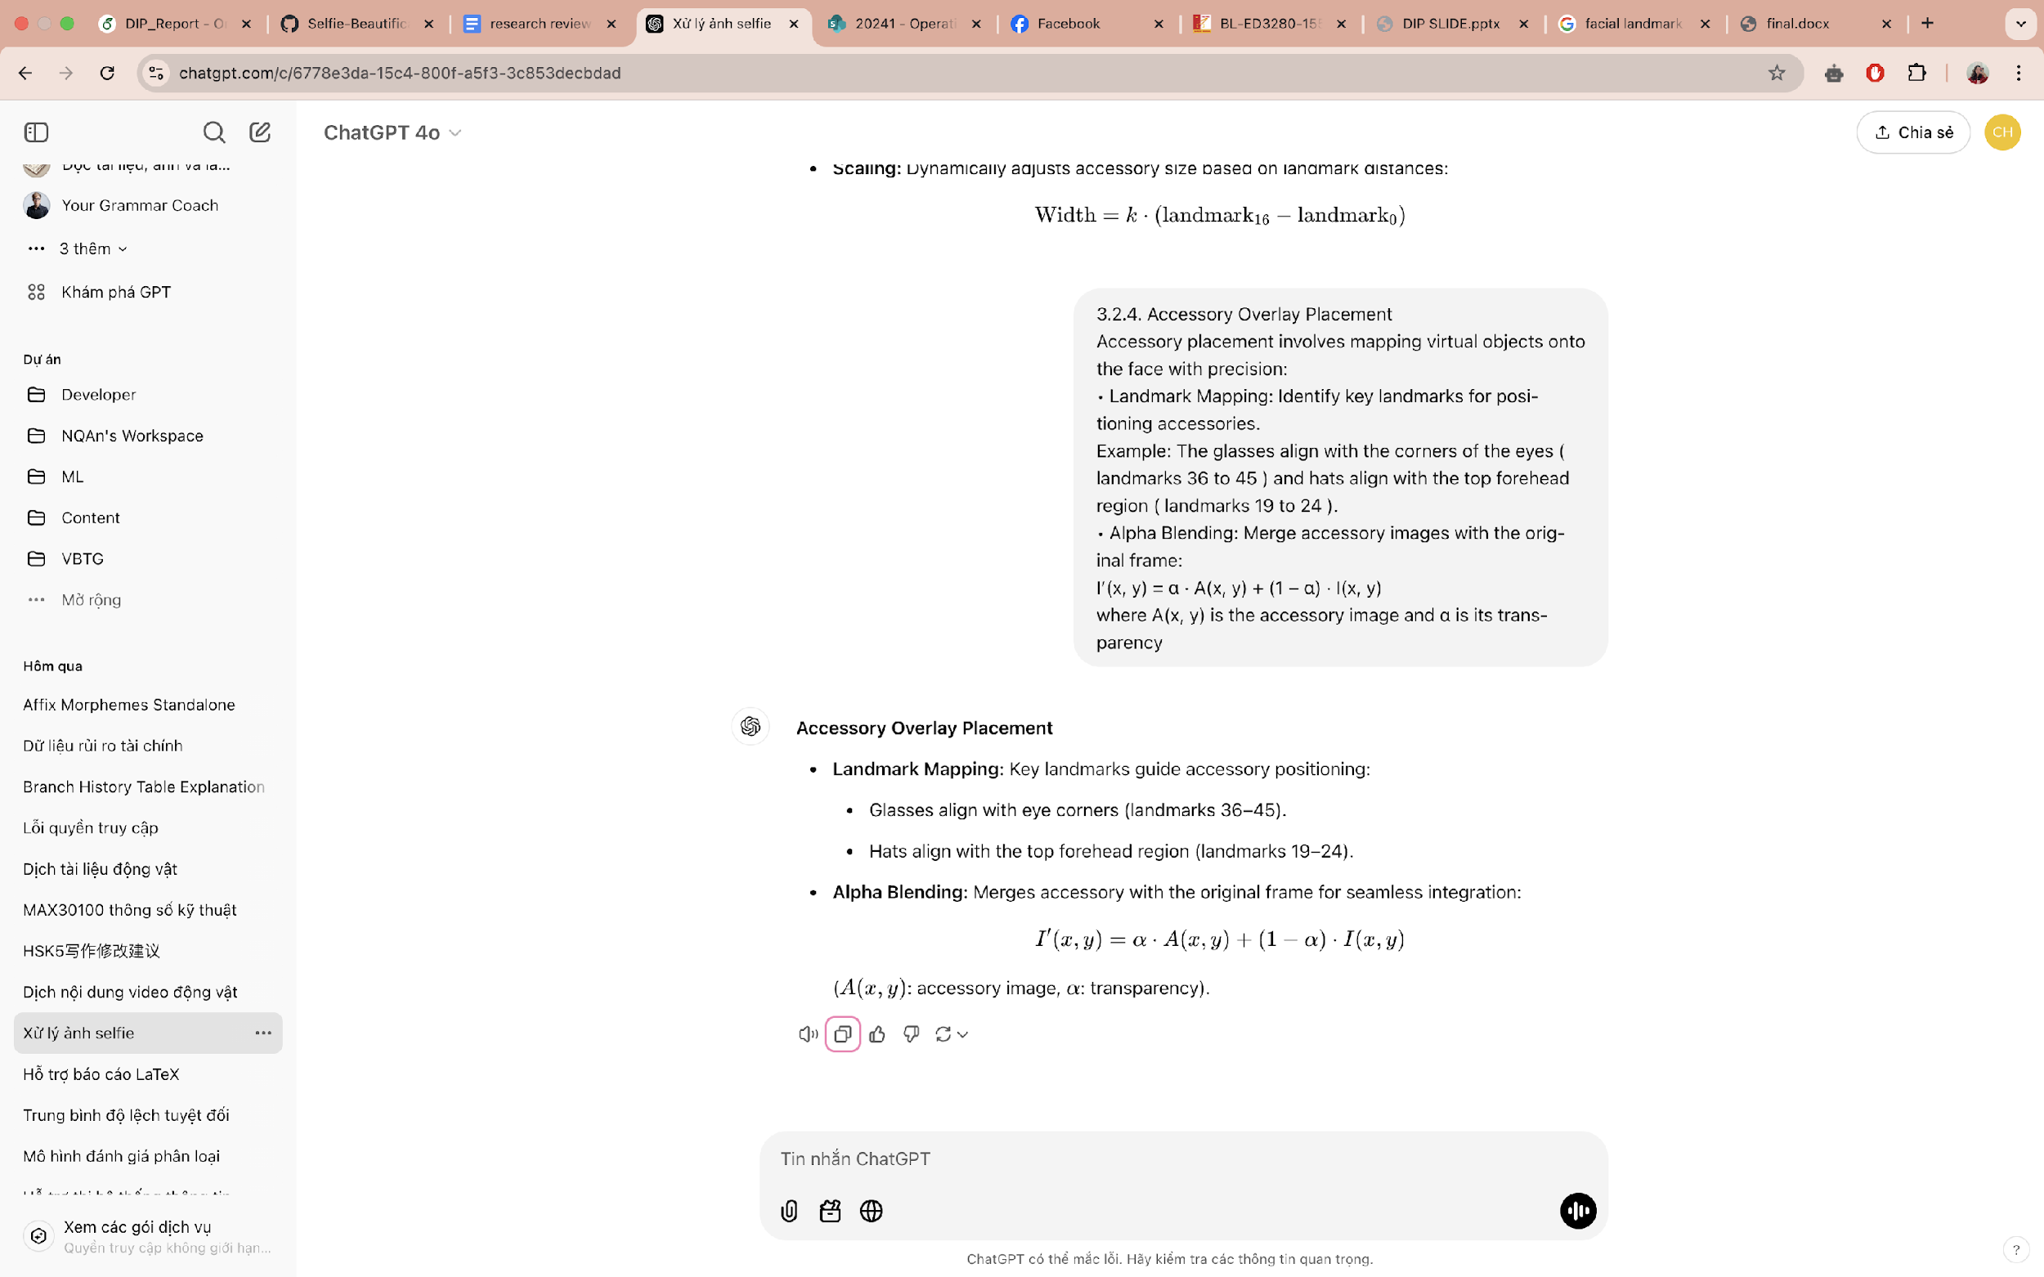
3.2.9. Accessory Overlay Placement
Landmark Mapping: Key landmarks guide accessory positioning:
Glasses align with eye corners (landmarks 36–45).
Hats align with the top forehead region (landmarks 19–24).
Alpha Blending: Merges accessory with the original frame for seamless integration:
where A(x,y): accessory image,
α: transparency

Slide 21

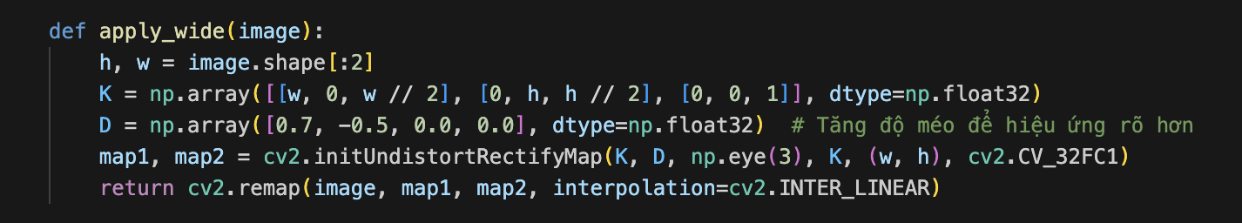
3.2.10. Wide-Angle Distortion
Effect: Simulates a fisheye view, distorting pixels based on their distance from the image center.
Distortion Model:
Camera Matrix (K): Represents intrinsic camera parameters:

Slide 22
3.3. Complexity
Face Detection: O(n) per frame, where n is the number of faces in a frame.
Landmark Extraction: O(m) where m=68 (Dlib’s model).
Filter Application: Ranges from O(k) for color adjustments to O(k2) for skin smoothing.

Slide 23
Experiment
04
Notes:
Now let's discuss how we evaluated our filters

Slide 24
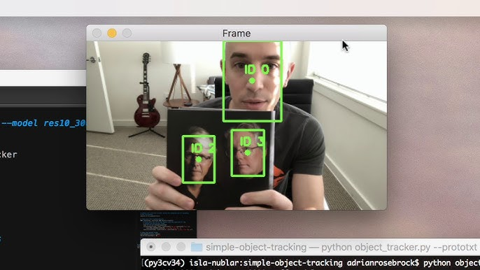
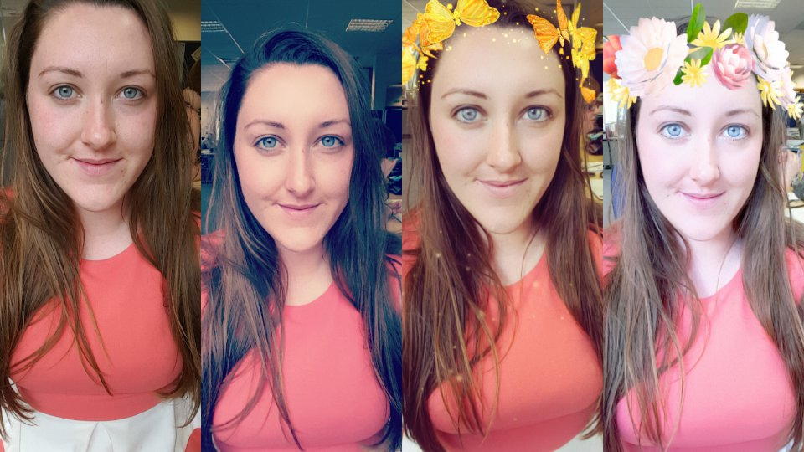
4.1. Experimental Setup
Device Configuration:
Device : MacBook Pro M2
Processor: Apple M2 (10-core GPU, 8-core CPU).
Memory: 16GB
Operating System: macOS Sonoma 14.2.1
Webcam: Integrated 1080p.
Libraries: OpenCV 4.10, dlib 19.24.6 , NumPy.
Testing Environment:
Real-time video processing tested under normal lighting conditions.
Frame resolution maintained at 1280x720 pixels for uniformity.
Notes:
"To begin, let’s discuss the experimental setup. All tests were conducted on a MacBook Pro M2. We utilized OpenCV and dlib for facial landmark detection and filter application. The evaluation involved 22 filters, categorized into accessory and artistic filters. Testing focused on real-time performance under normal lighting conditions and across various facial angles and positions. The primary objective was to validate both the system’s responsiveness and the visual quality of the filters."

Slide 25
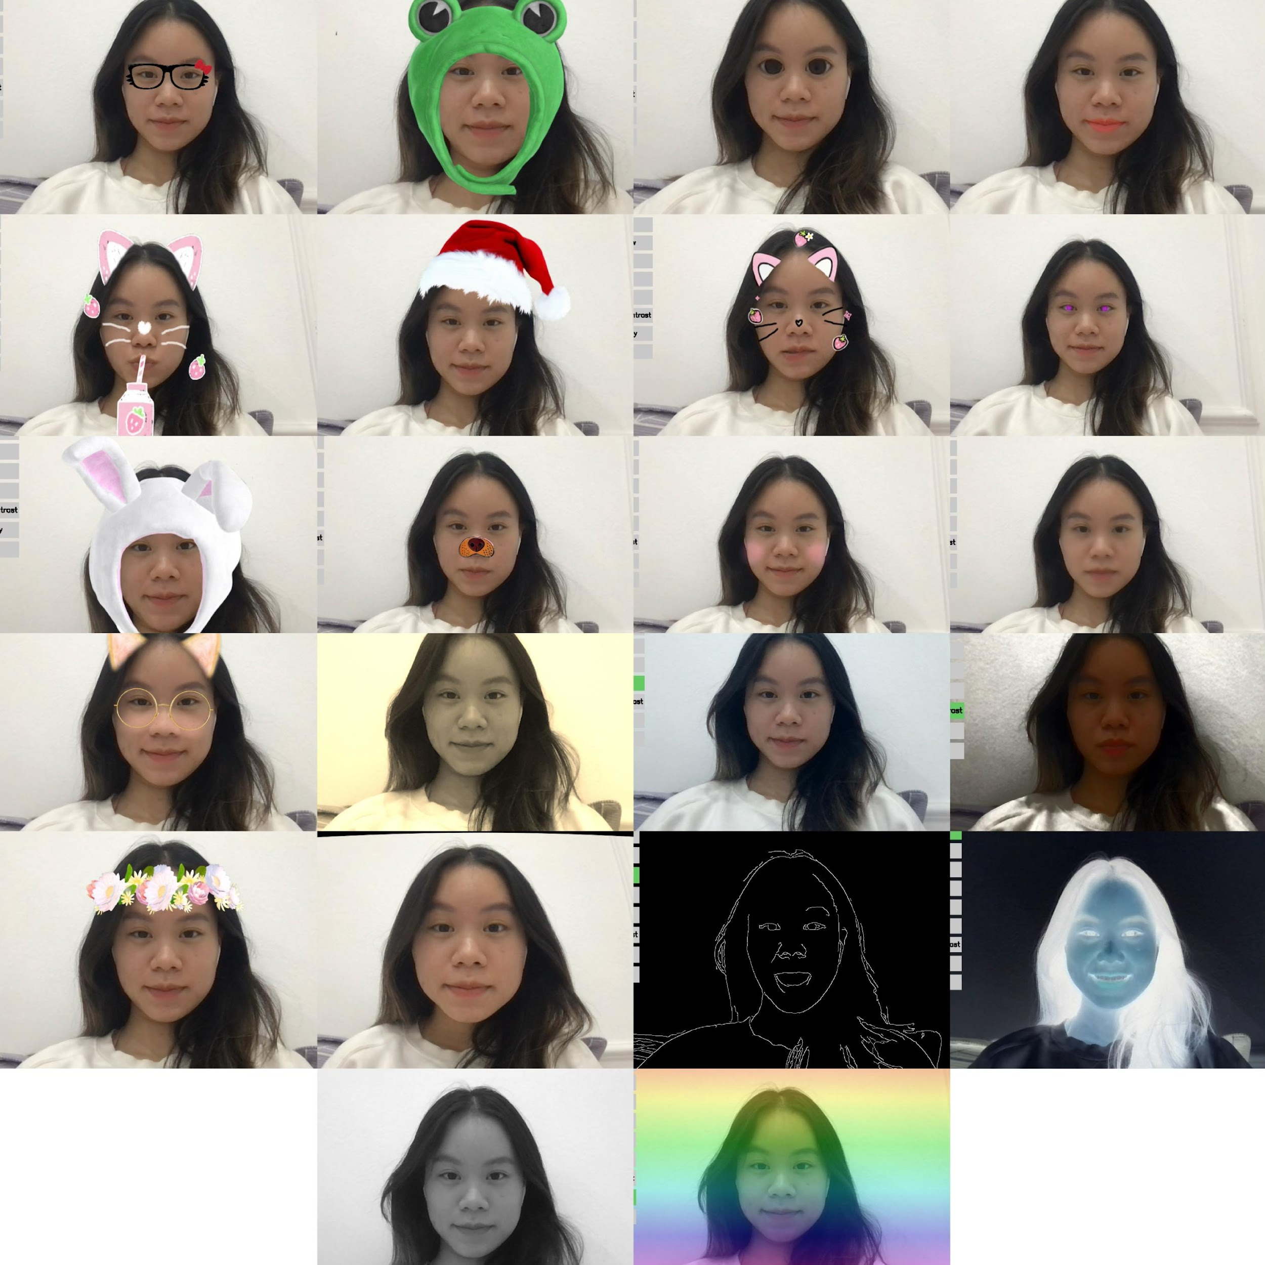
4.2. Evaluation Metrics and Process
Metrics Used:
FPS(Frames Per Second): Measures the real-time performance and smoothness of the system.
Visual Inspection: Determines the aesthetic appeal, natural alignment, and usability of filters through subjective evaluation.
Evaluation Process:
Step 1: Select and activate a filter.
Step 2: Observe FPS performance for 100 frames.
Step 3: Conduct visual inspection for alignment and clarity.
Step 4: Record observations and compute average FPS.
Notes:
"In terms of evaluation metrics, we relied on Frames Per Second (FPS) for quantitative assessment. A higher FPS value indicates better real-time responsiveness. For qualitative evaluation, we conducted visual inspections to assess filter alignment, clarity, and usability.
Metrics like PSNR and SSIM were excluded since our filters are custom-designed and lack standardized references. These metrics would not provide meaningful insights for our project.
Our evaluation process involved several steps. First, a filter was selected and activated. Then, FPS was observed and recorded over 100 frames to measure performance. Simultaneously, visual inspections were conducted to assess the aesthetic quality. Observations were documented, and average FPS values were computed."
"Let us now discuss the experimental results of our project.

Slide 26
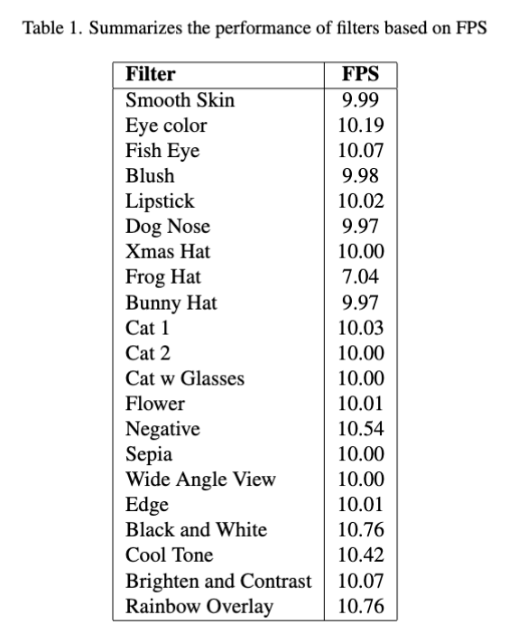
4.3. Experimental Results
Performance Highlights:
Accessory Filters: FPS ranged from 7.04 to 10.01
Artistic Filters: FPS consistently around 10
Observations:
Accessory Filters: Real-time performance slightly impacted by computational complexity. Have alignment issues during rapid head movement.
Artistic Filters: Smooth performance with stable FPS values.
Notes:
The table here shows the FPS values for all 22 filters. As you can see, simpler filters, such as Black & White and Rainbow Overlay, achieved the highest FPS values, exceeding 10. More computationally intensive filters, like Frog Hat, had slightly lower FPS but maintained acceptable performance levels for real-time applications.

Slide 27
4.3. Experimental Results
Visual assessment: Confirmed the effectiveness of filters, with observations including:
Artistic filters provided natural and aesthetically pleasing outputs.
Accessory filters aligned well with landmarks but showed minor misalignments during rapid head movements or significant distance changes.
Notes:
Through visual inspection, we observed that artistic filters like Sepia and Cool Tone delivered aesthetically pleasing results. Accessory filters like Bunny Hat and Frog Hat aligned well under normal conditions but showed occasional misalignments during rapid head movements."

Slide 28
Conclusion
05

Slide 29
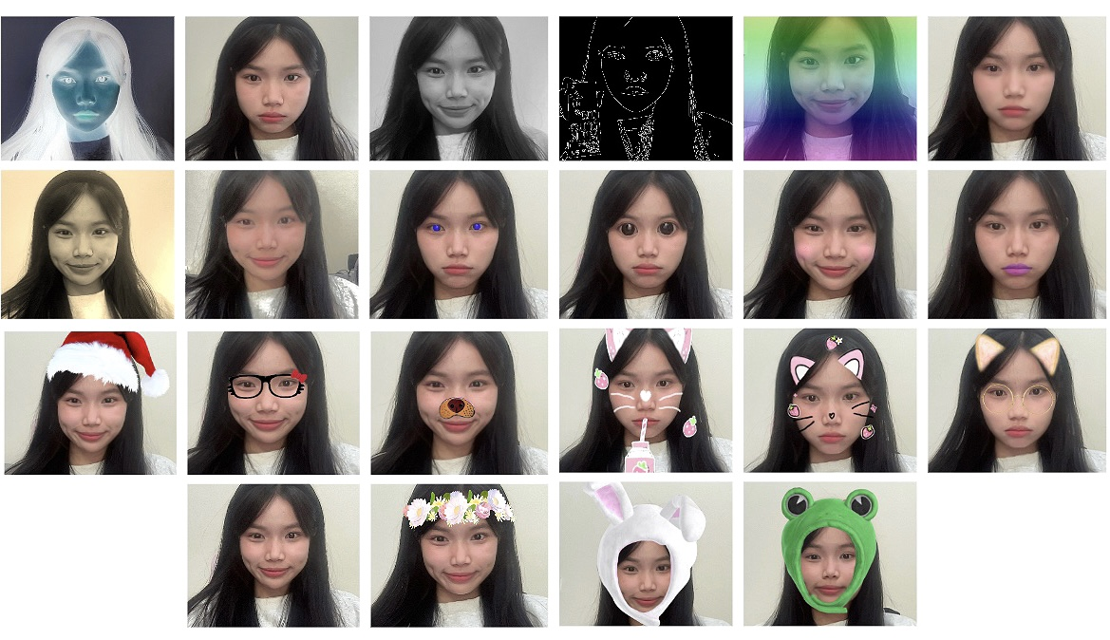
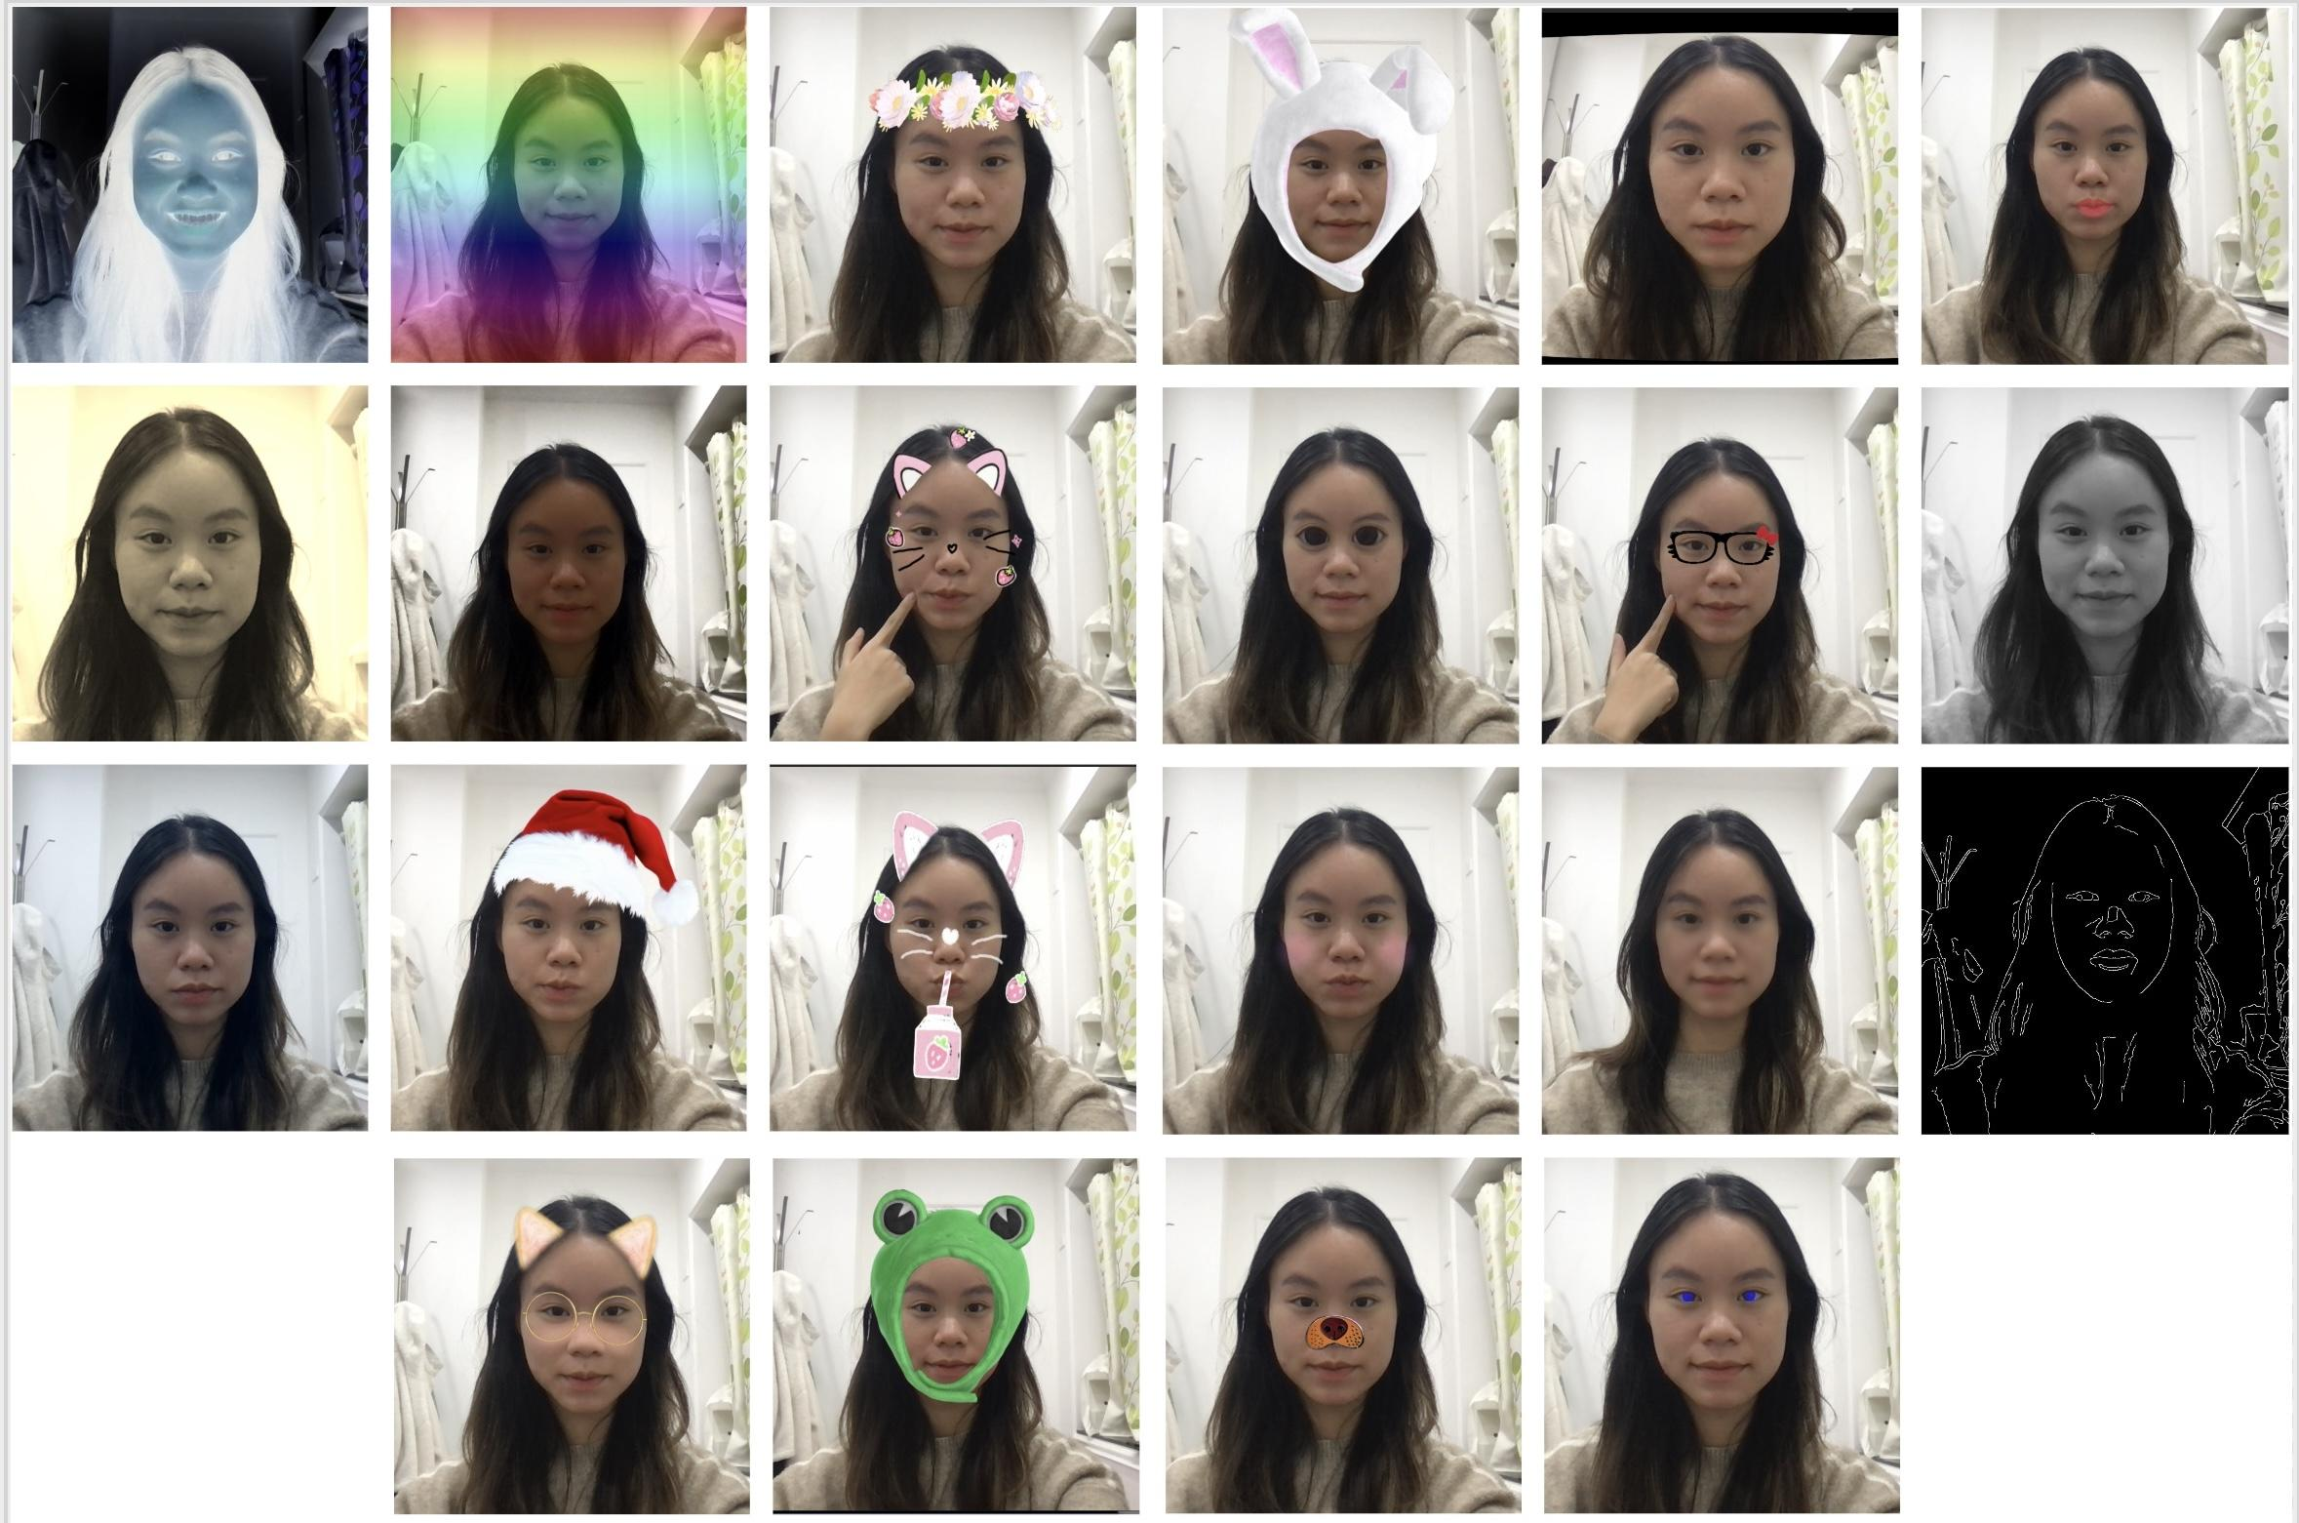
5. Conclusion
Success:
Real-time performance with FPS above 10 for most filters.
User feedback and aesthetic evaluation validate filter effectiveness.
Limitations:
No standardized reference for comparison
Real-time alignment issues for accessory filters during rapid movement
Future Work:
Advanced face tracking for better alignment.
Explore dataset augmentation for evaluation.
Adding interactive motion-based effects like snowfall or rain.
Notes:
"In conclusion, our project successfully implemented 22 filters, showcasing the potential of real-time image enhancement. The system achieved high FPS values, ensuring seamless performance in live video applications. Visual inspections confirmed the effectiveness of artistic filters in enhancing aesthetics, while accessory filters provided engaging augmented reality experiences.
However, challenges remain. Tracking accuracy for accessory filters needs improvement to handle dynamic conditions better. Additionally, the lack of direct reference filters limited our ability to perform comprehensive quantitative evaluations.
In the future, we aim to integrate advanced facial tracking models and optimize the system for mobile platforms. Expanding the dataset with reference filters from popular applications will also enable more robust evaluations."

Slide 30
References
06

Slide 31
6. References
John Doe and Jane Smith. An example paper. Journal of AI Research, 10(3):123–145, 2025.
Rafael C. Gonzalez and Richard E. Woods. Digital Image Processing. Pearson, 3rd edition, 2008.
Ivan Gryshchenko et al. Real-time 3D face reconstruction with MediaPipe Face Mesh. arXiv preprint, 2020.
Kaiming He, Jian Sun, and Xiaoou Tang. Guided image filtering. IEEE Transactions on Pattern Analysis and Machine Intelligence, 35(6):1397–1409, 2010.
Davis E. King. Dlib-ml: A machine learning toolkit. Journal of Machine Learning Research, 10:1755–1758, 2009.
Carlo Tomasi and Roberto Manduchi. Bilateral filtering for gray and color images. In Proceedings of the International Conference on Computer Vision (ICCV), pages 839–846, 1998.
Matthew Turk and Alex Pentland. Eigenfaces for recognition. In Proceedings of the IEEE Conference on Computer Vision and Pattern Recognition (CVPR), pages 586–591. IEEE, 1991.
Paul Viola and Michael Jones. Rapid object detection using a boosted cascade of simple features. Proceedings of the IEEE Conference on Computer Vision and Pattern Recognition (CVPR), pages 511–518, 2001.
Xi Yin et al. BeautyGAN: Instance-level facial makeup transfer with deep generative adversarial network. In Proceedings of the 26th ACM International Conference on Multimedia, pages 645–653, 2018.

